Slide 1




Coherent and Incoherent Alternating Structure
L₀
ray optics
CS:1
EM wave optics
L₁
ray optics
CS:2
EM wave optics
$$……$$
ray optics
emitter
EM wave optics
mode
M1$↑$
M2$↑$
$$……$$
M3$↓$
M4$↓$
ray optics
CS:n-1
EM wave optics
L_{n-1}
ray optics
CS:n
EM wave optics
L_{n}
ray optics
Incoherent Layers

Slide 2

start
Load Material/User
start
Load Structure/Structure List
$$\frac{k_{t}}{k_{o}},θ_{k_{t}}$$
Output setup (plot/write)
Calculate
$$\frac{k_{x}}{k_{o}},\frac{k_{y}}{k_{o}}$$
Angle/XY
Power density (coherent)

Slide 3
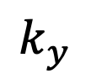



$$k_{y}$$
$$k_{t}$$
$θ_{k_{t}}$
$$k_{x}$$

Slide 4
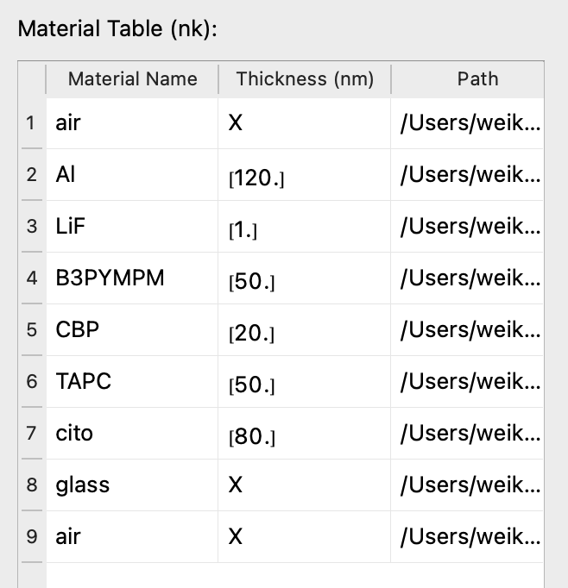
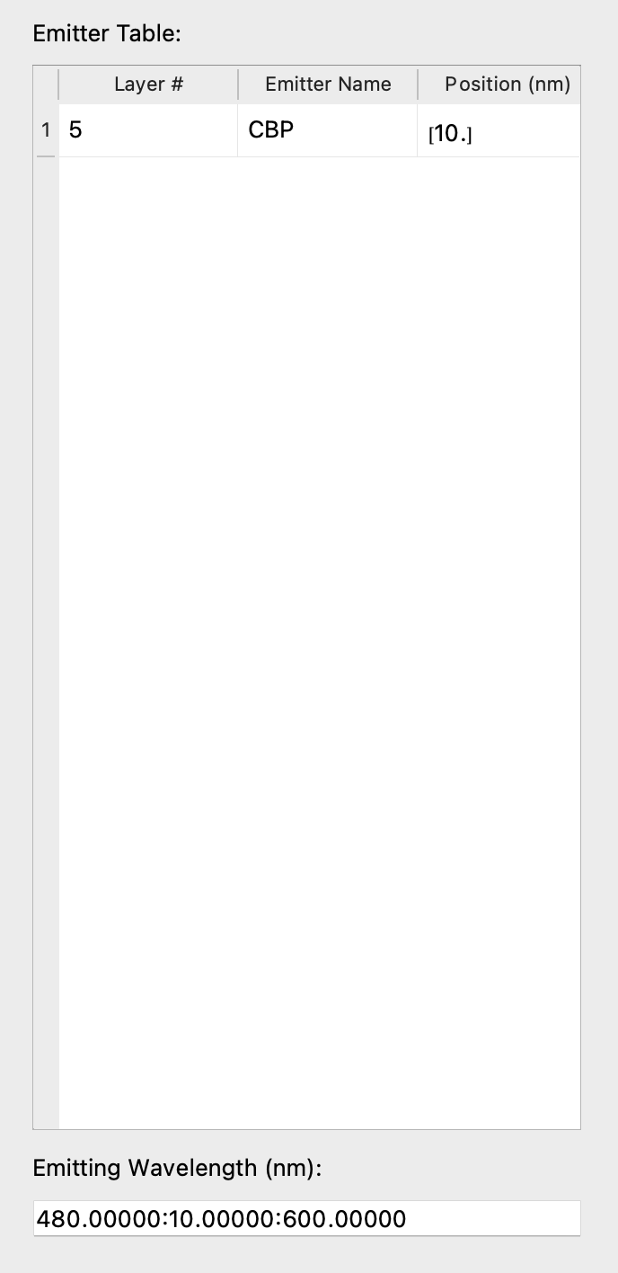
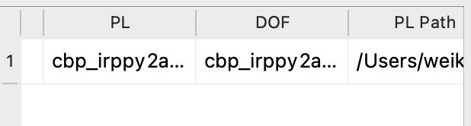
(a) device structure
(b) EML
(c) emitting wavelength

Slide 5
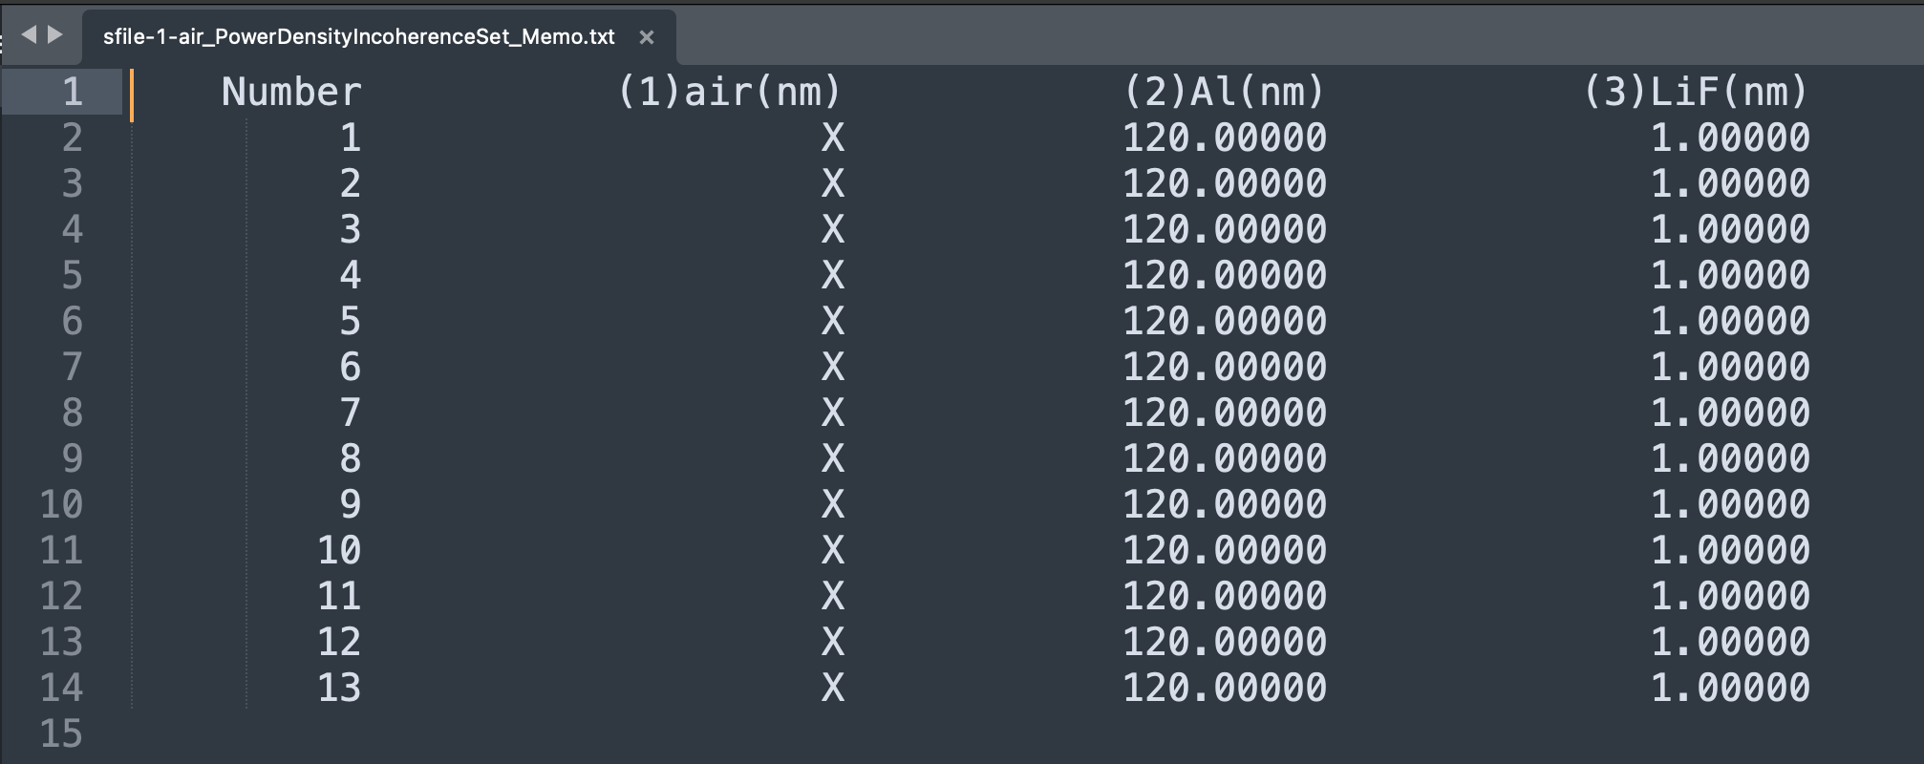
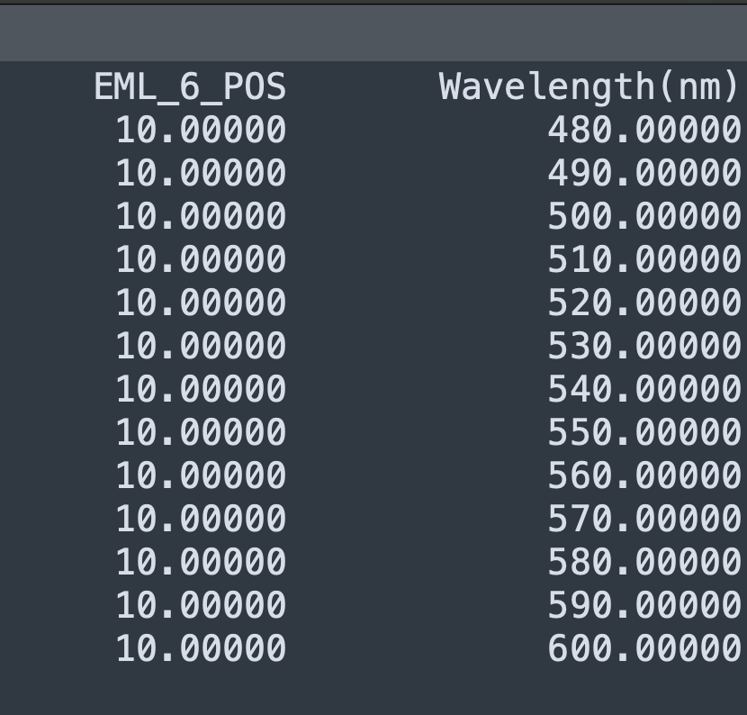

Slide 6
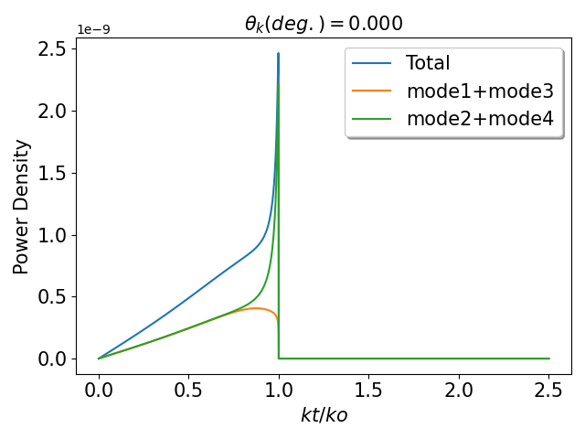
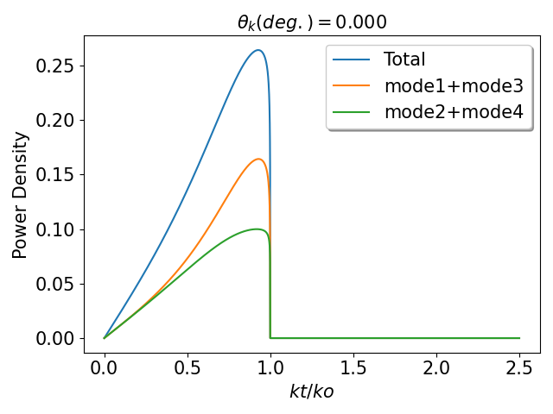
Incoherent Layer 1:Air
Incoherent Layer 2:glass
Incoherent Layer 3:air

